Slide 1
COMP 4290
Week 10 - Wednesday

Slide 2
Last time
Finished network vulnerabilities
Network security controls
Firewalls

Slide 3
Questions?

Slide 4
Project 3

Slide 5
Aidan Kent Presents

Slide 6
Intrusion Detection

Slide 7
Intrusion detection
Firewalls and authentication mechanisms are supposed to prevent malicious attacks
Not all attacks can be prevented
  But it's still useful to know when they are happening
An intrusion detection system (IDS) is hardware or software that monitors activity to look for suspicious patterns
A network-based IDS is stand-alone hardware that monitors a whole network
A host-based IDS runs on a host to protect that host

Slide 8
Types of IDSs
Signature-based IDSs do pattern matching, looking for patterns of known malicious behavior
  Only works for known types of attacks
Heuristic (or anomaly based) IDSs build up a model of acceptable behavior
  If something doesn’t fit the model, an alarm is raised
  An example is a particular user who has a characteristic way of typing that suddenly changes
State-based IDSs try to see when the system is in an unsafe state
Model-based IDSs try to model unacceptable activity and react when activity looks like the model
Misuse intrusion detection is like model-based except that the model is known bad behavior

Slide 9
IDS operation
Many IDSs are configured in stealth mode
  They cannot send messages on the network they are monitoring
  Alarms are sent through some alternate means
Responding to alarms
  Monitor data
  Change system settings to protect it
  Alert a human being
Because they are often statistical, an IDS can have false positives and false negatives
  Both are problematic

Slide 10
Database Background

Slide 11
What is a database?
A database is a collection of data and a set of rules to organize the data by relationships
A database administrator makes the rules and controls access
A database management system (DBMS) is the program through which the user interacts with the database

Slide 12
Database components
Most modern databases use the relational database model
  The fundamental unit of organization is a table
  An older format for databases was hierarchical, like a tree
A table consists of records
A record consists fields or elements, which are each a specific item of data

Slide 13
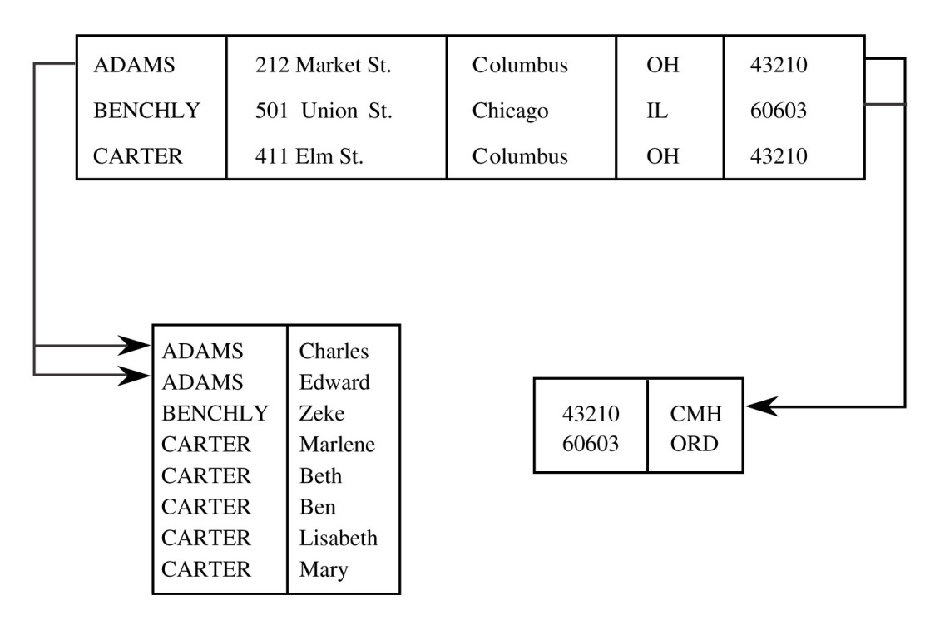
Schemas
The tables in a database are usually related to each other in some way
The logical structure of a database is called a schema
A user may only see part of it, called a subschema
An attribute is the name of a column
A relation is a set of columns

Slide 14
Queries
A query is the name of a command given to a database by a user
Queries can:
  Retrieve
  Modify
  Add
  Delete
Most databases allow commands to be issued through a variant of SQL

Slide 15
Table example
Table CLIENTS
Name | First | Address | City | State | Zip | Airport
ADAMS | Charles | 212 Market St. | Columbus | OH | 43210 | CMH
ADAMS | Edward | 212 Market St. | Columbus | OH | 43210 | CMH
BENCHLY | Zeke | 501 Union St. | Chicago | IL | 60603 | ORD
CARTER | Marlene | 411 Elm St. | Columbus | OH | 43210 | CMH
CARTER | Beth | 411 Elm St. | Columbus | OH | 43210 | CMH
CARTER | Ben | 411 Elm St. | Columbus | OH | 43210 | CMH
CARTER | Lisabeth | 411 Elm St. | Columbus | OH | 43210 | CMH
CARTER | Mary | 411 Elm St. | Columbus | OH | 43210 | CMH

Slide 16
Query example
Query:
SELECT * FROM CLIENTS WHERE FIRST="BEN" OR CITY="CHICAGO"
Name | First | Address | City | State | Zip | Airport
BENCHLY | Zeke | 501 Union St. | Chicago | IL | 60603 | ORD
CARTER | Ben | 411 Elm St. | Columbus | OH | 43210 | CMH

Slide 17
Database advantages
Databases have many advantages:
  Shared access for many users
  Minimal redundancy so that space is used efficiently
  Data integrity with rules that protect relationships
  Controlled access with authorized users
Databases have also been heavily optimized for speed
Users don’t need to know anything about the actual physical layout of the database on disk

Slide 18
Database Security Requirements

Slide 19
Database security requirements
Because they are a central part of modern business, several aspects of database security are crucial:
  Physical database integrity
  Logical database integrity
  Element integrity
  Access control
  User authentication
  Availability

Slide 20
Database integrity
Physical database integrity
  What happens in a power failure?
  Disk drives fail all the time
Regular backups are necessary
Google and Amazon offer distributed database services
Transaction logs should be kept

Slide 21
Element integrity
The integrity of an individual element is its correctness or accuracy
Field checks make sure that data values fall within appropriate ranges or have the right types
  Usually these checks are done as data is being entered
Access control is key
  Partly to protect data from malicious users
  Partly to avoid situations where two users update information at the same time, leading to inconsistency
A change log keeps track of all changes, allowing for an undo of mistaken updates

Slide 22
Auditability
Like with OS logs, we want to be able to keep track of who has accessed the database
Similarly, the log can become very long
Should we record when a user has indirectly accessed a value through a SELECT statement?
  This is called the pass-through problem

Slide 23
Access control and authentication
Managing access control for a database is very difficult
  Many systems allow for very fine-grained control
  But some human has to assign all the privileges
Worse, giving a person access to some data but not others might not be enough
Some queries can leak information about hidden data
  Getting this data is called inference
Most DBMSs are separate from the OS
  Since there is no trusted path, the DBMS must do its own authentication

Slide 24
Availability
Availability is another challenge for a DBMS
Since these systems make the world work, everyone notices when they go down
If a field is not available to user A while user B is editing it, user A may have to wait an unacceptable amount of time
To avoid inference, data that should be publicly known might be unreasonably hidden
CIA all come together in DBMSs

Slide 25
Database Reliability and Integrity

Slide 26
Reliability and integrity
Reliability is a measure of how long a software system can run without failing
  Reliability is often quoted in terms of uptime percentage
  Or mean time between failures
Database reliability and integrity has three aspects:
  Database integrity
    Is the database as a whole protected from disk failure or corruption
  Element integrity
    Are only authorized users allowed to change elements
  Element accuracy
    Are the values in the elements correct

Slide 27
Two-phase update
A key problem for database integrity is what happens if the system fails in the middle of an update
  Then the database is inconsistent
A two-phase update is a common solution
  During the intent phase, the DBMS computes the results needed for the update, but does not change the database
  During the commit phase, it changes all of the fields to the values computed in the intent phase
  If the intent phase fails, the DBMS can start over from the beginning
  If the commit phase fails, the DBMS can try to write all the data from the intent phase again

Slide 28
Two-phase example part 1
Avon and Stringer use a database to organize their heroin distribution cartel
  Assume that they have 1483 doses in their warehouse
If a request for a re-up for 100 WMD's comes from the Pit's crew chief, the following steps happen:
They check the warehouse to see if they have enough, otherwise the request is postponed
If they have enough, they remove 100 from the warehouse (1483 – 100 = 1383)
They add 100 doses to the crew chief's sheet of product
  If the crew chief is more than 1000 doses behind on payment, he is shot
If the warehouse's quantity on hand (1383) is below 500, an order is made to the Greek importers for another heroin shipment
The re-up delivery to the Pit is made

Slide 29
Problems
If the steps are not correctly carried out in order, bad things happen
Imagine a failure in the process
  If 100 is removed from the warehouse inventory field and the process fails, the accounting for the warehouse is off
  If repeated failures cause 100 doses to be added to the crew chief's sheet several times without a delivery, he might get shot
In the two-phase system, we use shadow values to keep track of changes
When the process has finished, we write the list of shadow values

Slide 30
Two-phase example part 2
To make the protocol robust to failure, we use the following intent phase:
Check the COMMIT-FLAG, if true, return failure or wait until false
Check the warehouse to see if they have enough, otherwise the request is postponed
Compute TDOSES = ONHAND - REQUESTED
Compute TSHEET = SHEET + REQUESTED
If TSHEET > 1000, set TKILLCHIEF = true, otherwise set TKILLCHIEF = false
If TDOSES < 500, set TREORDER = true, otherwise set TREORDER = false

Slide 31
Two-phase example part 3
This is the corresponding commit phase:
Set the COMMIT-FLAG in the database
Set ONHAND = TDOSES
Set SHEET = TSHEET
Set KILLCHIEF = TKILLCHIEF
Set REORDER = TREORDER
Unset COMMIT-FLAG
When finished, make the delivery

Slide 32
Redundancy
DBMSs often keep information for error correction and detection:
  Parity bits
  Hamming codes
  Cyclic redundancy checks
Shadow fields (like the ones used in two-phase updates) can be used to replicate individual fields or entire records
Because events are also logged, it should be possible to reconstruct the database from a backup based on the log data

Slide 33
Concurrency
Most database systems allow more than one user or process to access it at the same time
Updates must be controlled to avoid race conditions
  Race conditions are sequences of commands that result in different states depending on timing
  If there is one ticket left to a Bad Bunny concert, it should be impossible for two people to buy it
Commands that both query (is there a ticket remaining) and update (buy the ticket) should be executed atomically
Reading data also needs to be protected
  If a user is writing data, it should be locked so that it can't be read

Slide 34
Constraints
A monitor is the part of the DBMS responsible for structural integrity
Range comparisons check newly entered numerical data for sanity
Filters or patterns can be arbitrarily complex to make sure that a zip code or a VIN is correctly formatted
The job of a DBA is to set these up, as well as the more complex state and transition constraints

Slide 35
State and transition constraints
A state constraint is a characteristic that should be invariant over the database
  Only one person is labeled president
  Only one table has a given name
  If such a constraint is violated, something has gone wrong in the database
A transition constraint must be met before certain changes can be made to the database
  A vacant position has to be listed before a new employee can be added
  A student record must exist before that student's ID can be added to a class

Slide 36
Upcoming

Slide 37
Next time…
Database disclosure
Database inference
Big data and data mining
Nfaly Toure presents

Slide 38
Reminders
Read Sections 7.3 through 7.5
Work on Project 3
  User names and passwords need to be turned in next Friday in class

